Slide 1

Asura:The StoryLine
Group No. 07
Aaryan Parab | 18104060
Nikhil Rathod | 18104001
Tanaya Patil | 18104022
Project Guide Prof. Neha Deshmukh

Slide 2
Contents
Introduction Objectives Problem Definition
Technological Stack
Review Suggestions (Given in Last meeting) Proposed System Architecture/Working Prototype Design Demonstration Implementation Status
Status of Paper Draft & Targeted Conference
●
●
●
●
●
●
●
●
●

Slide 3
1. Introduction
•
Problem Identified :
Indian culture has played an important role in molding our lives. Now-a- days our new generation is steering a course towards Modernization and western culture and we can see lack of interest in Indian Culture and Mythology in our younger generation.
•
Solution Proposed :
To overcome this problem we will develop 3D video game that will introduce youngsters to Indian Mythological Concepts in a interactive as well as fascinating way.

Slide 4
2. Objectives
To build a video game involving the Indian Culture.
To involved youngsters in Indian Culture in an entertaining way.
To build 3 dimensional visual world with high graphics.
To create an exciting game scenes and animations using Unity3D and After Effects.
To achieve perfect efficiency in creating 3D modelling using blender
To create ,edit and restoring audio using Auditions.

Slide 5
3. Problem Definition
The young Indians more obsessed with the latest trends of globalization.
To overcome this problem we have implemented a solution in which 3D game will be made to increase youngsters involvement in Indian culture and Mythology in an interactive as well as in fascinating way.

Slide 6
4. Technological Stack
Unity 3D : To build game scenes.
Blender/Maya : To create 3D models.
Photoshop/Illustrator : To edit the models used in game.
Audition tool : To create or edit the audio.
After Effects tool : To give an animation.

Slide 7
5. Reviews and Suggestions
1. To work on the title of the project.

Slide 8
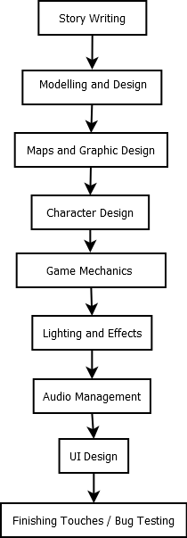
6. Proposed System Architecture/ Working

Slide 9
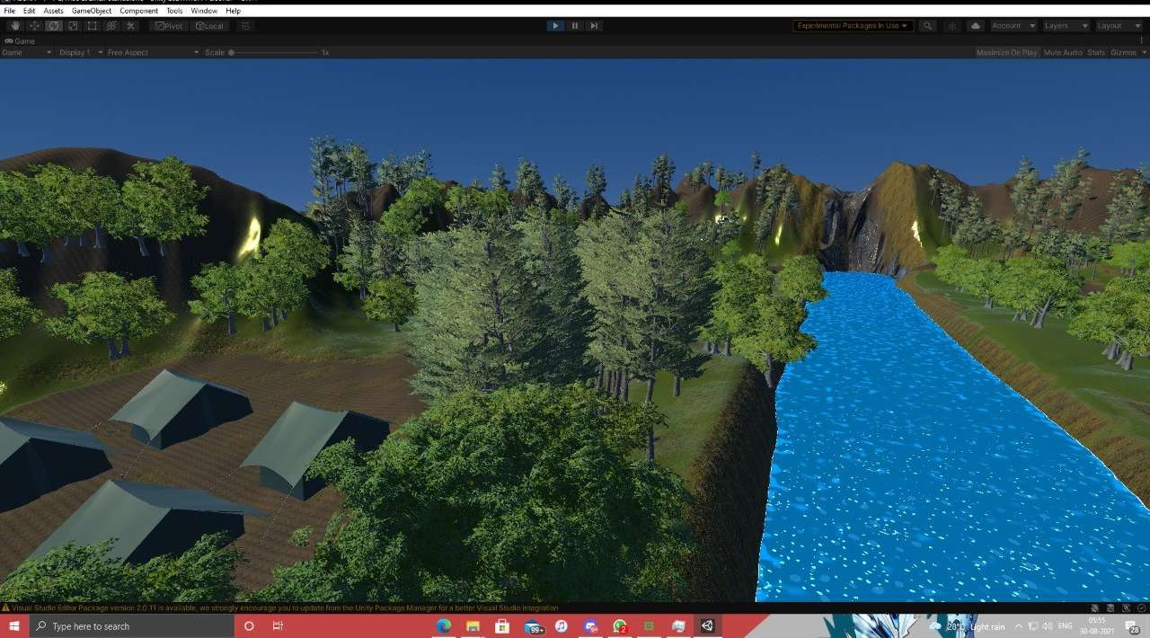
7. Prototype Design Demonstration

Slide 10
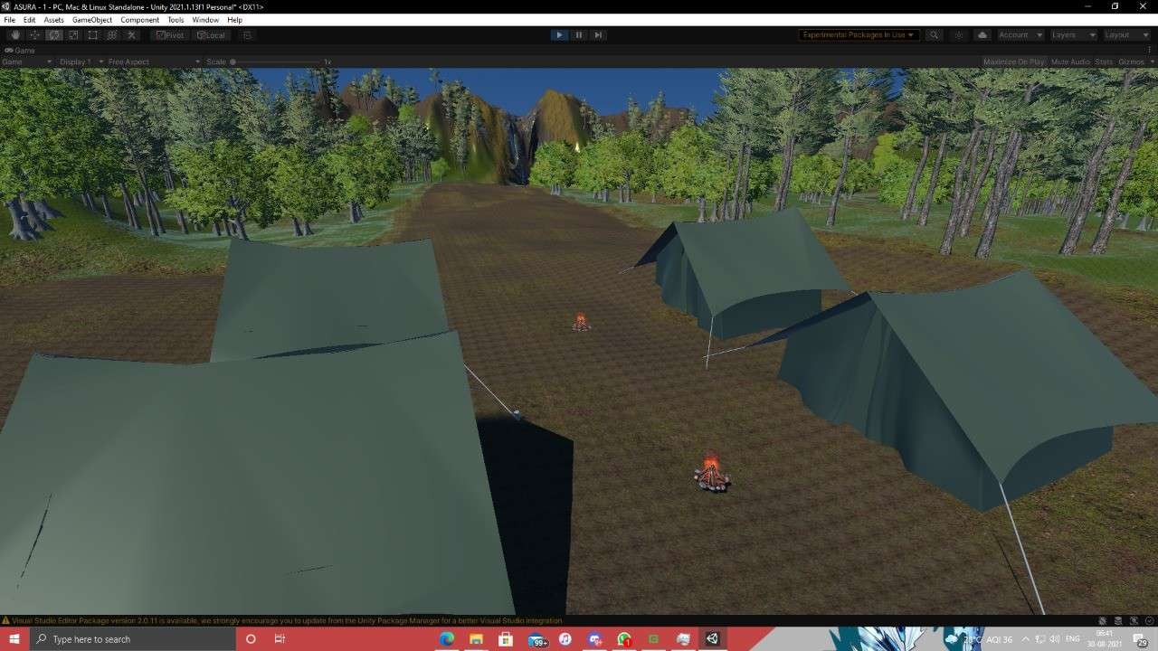

Slide 11
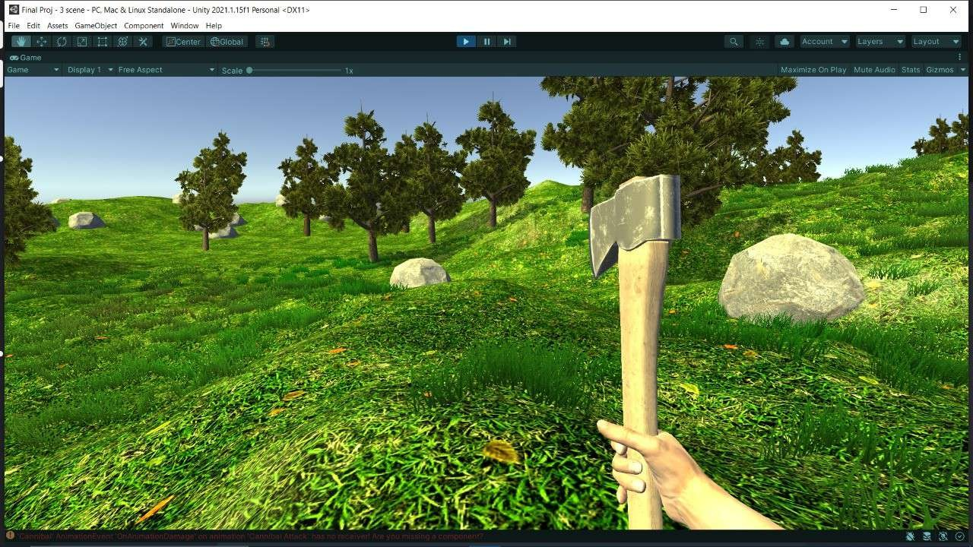

Slide 12
8. Implementation Status
Done with 1st level map or scene.
Done with player scripts.
Working on 1st puzzle.
Working on enemy scripts.

Slide 13
9. Status of paper draft and targeted conference
Completed Abstract
Completed Introduction
Working on Methodology
Targeted Conference is IEEE and 14th International Conference on E-Learning and Games

Slide 14
Thank You...!!

